Slide 1
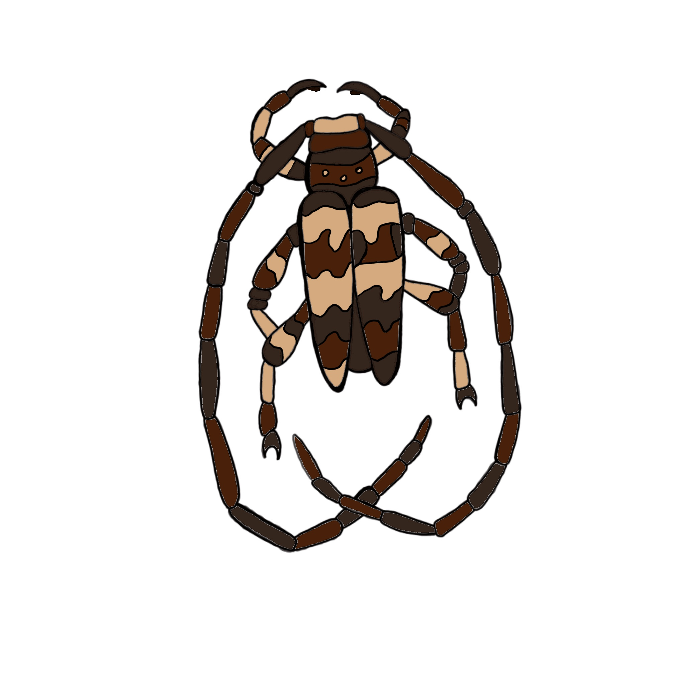

Assessing Disease Transmission Following Fire Disturbance in Rocky Mountain Forests
Hailee Amethyst Nolan, Thomas Seth Davis

Slide 2
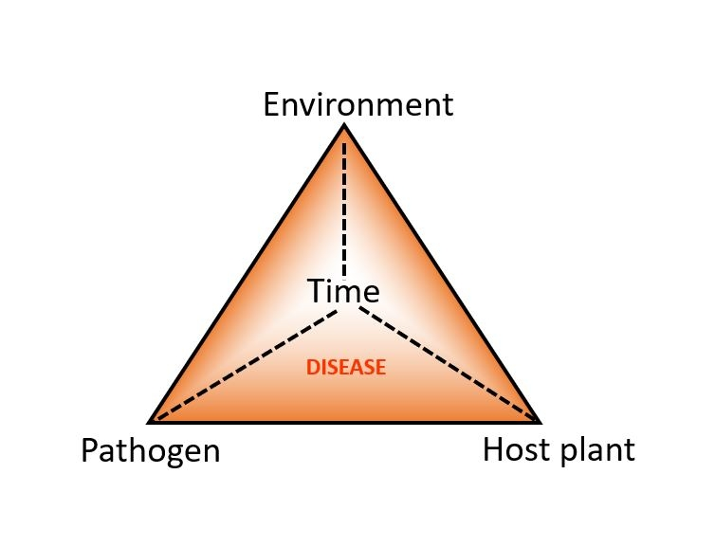
Disease Triangle:
Notes:
Disease caused by a vector Requires interaction
Time important- disease occurrence and intensity could be affected by the duration that these factors are aligned
Changing world, environment aspect altered with rising natural disasters and disturbance

Slide 3
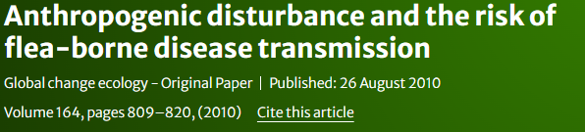
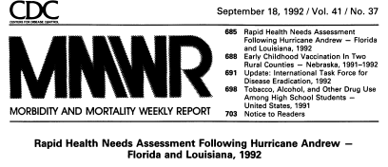

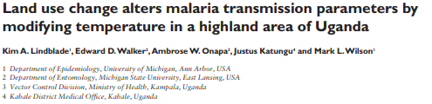
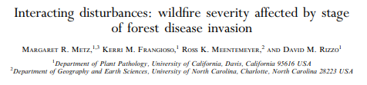
Disturbance and Disease:
Notes:
Higher abundance of vectors or more efficient vectors after disturbance
Percent infested mammals increased with increasing disturbance
Increased risk of diseases like malaria
And in our forests, wildfire disease interact- fuel abundances as well as increased fire after pathogen invasion

Slide 4
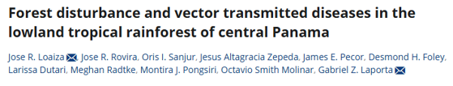
Disturbance Specialists:
Climax species: disturbance generalist- tend to decrease in abundance along with rising levels of disturbance.
Colonist species: disturbance specialist- tend to increase in numbers toward more disturbed forest habitats.
Notes:
Panama - mosquitoes, sandflies, and midges in forests
found that disturbance had varying effects on vector abundance depending on species. They separated species into

Slide 5
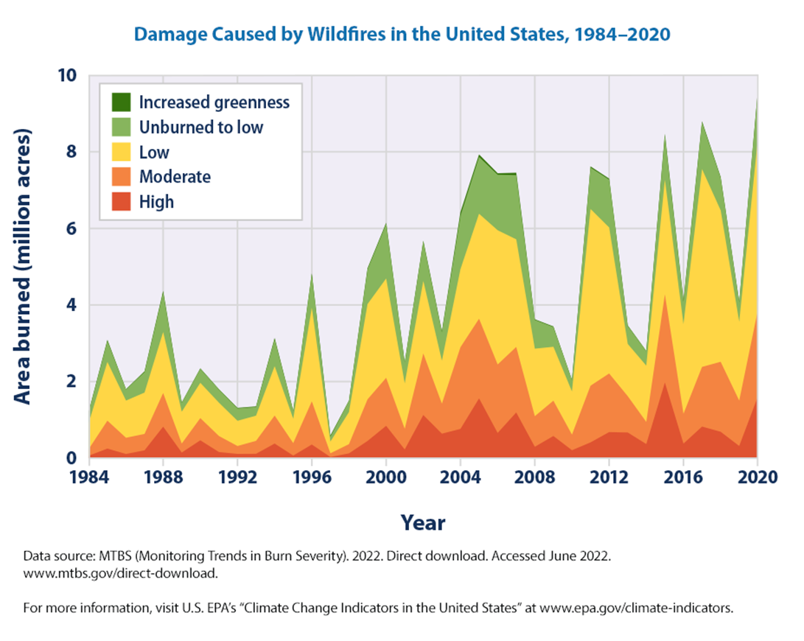
Increasing Wildfire:
Notes:
In our landscape, frequency and intensity over the past few decades. Trend driven by
Wildfire damage unprecedented levels significantly altering

Slide 6
Knowledge Gap:
Increased disturbance = increased abundance of vectors as well as infestation rates.
Well documented in vectors of human and animal pathogens.
Less is known about the spread of plant diseases after disturbance.
How might ecological disturbances contribute to increased disease transmission in forest ecosystems?
Notes:
In particular, I wanted to investigate how wildfire might affect the spread of disease.

Slide 7
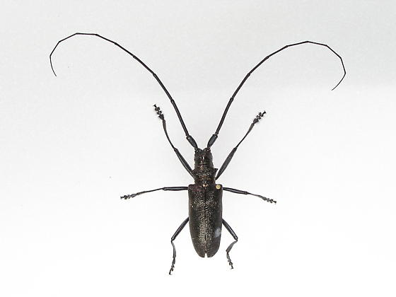
Colonist species: disturbance specialist- tend to increase in numbers toward more disturbed forest habitats.
Monochamus scutellatus
27 mm
(1.06 Inches)

Slide 8
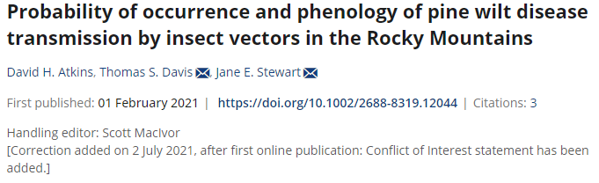
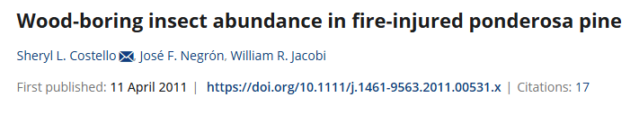
Previous Work
Notes:
Previous work in THIS study area
Proximity to fire footprint was a big predictor of beetle abundance

Slide 9
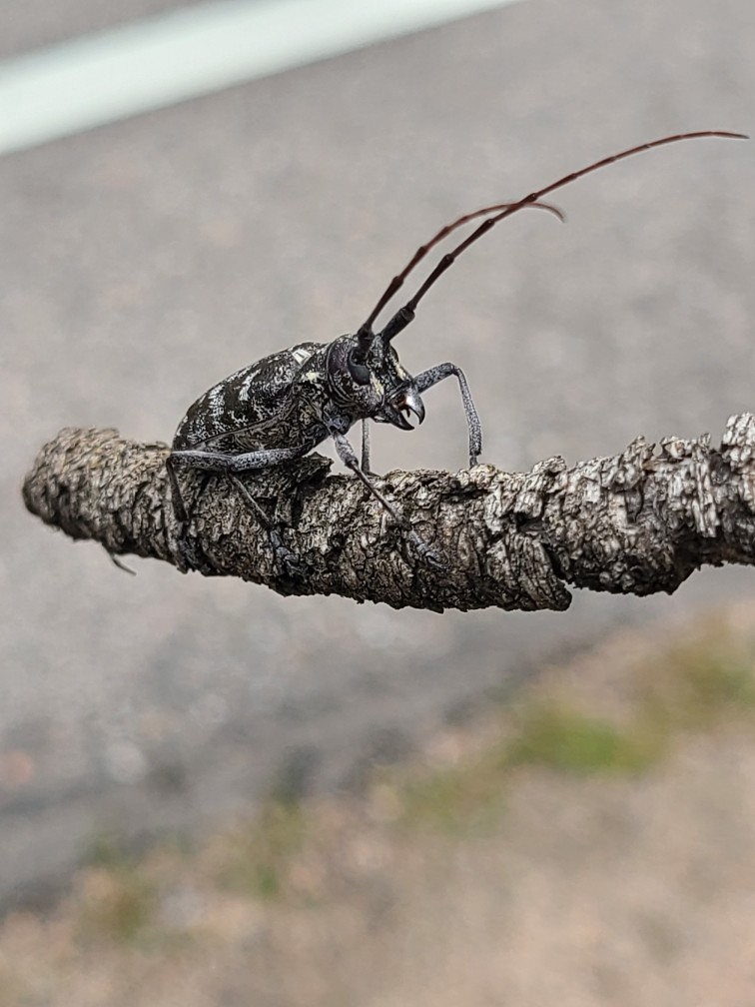
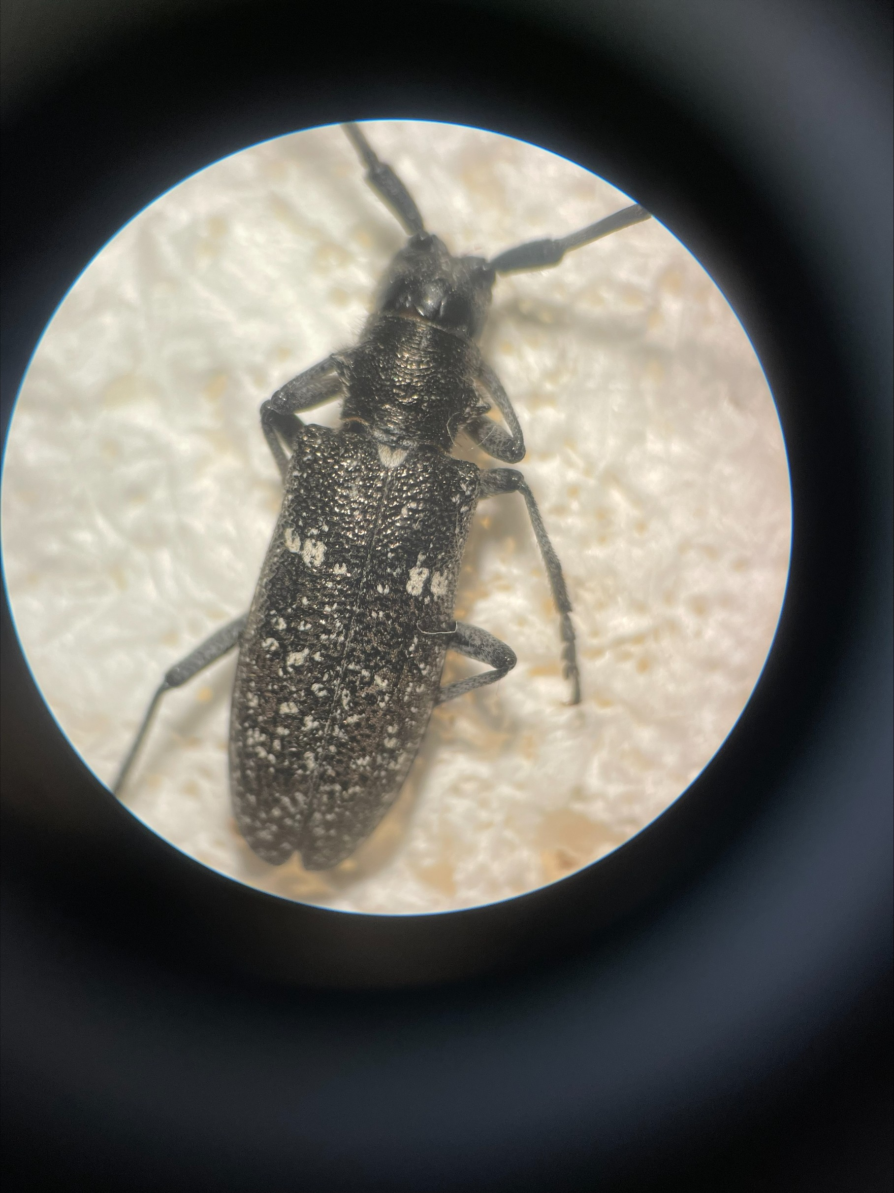
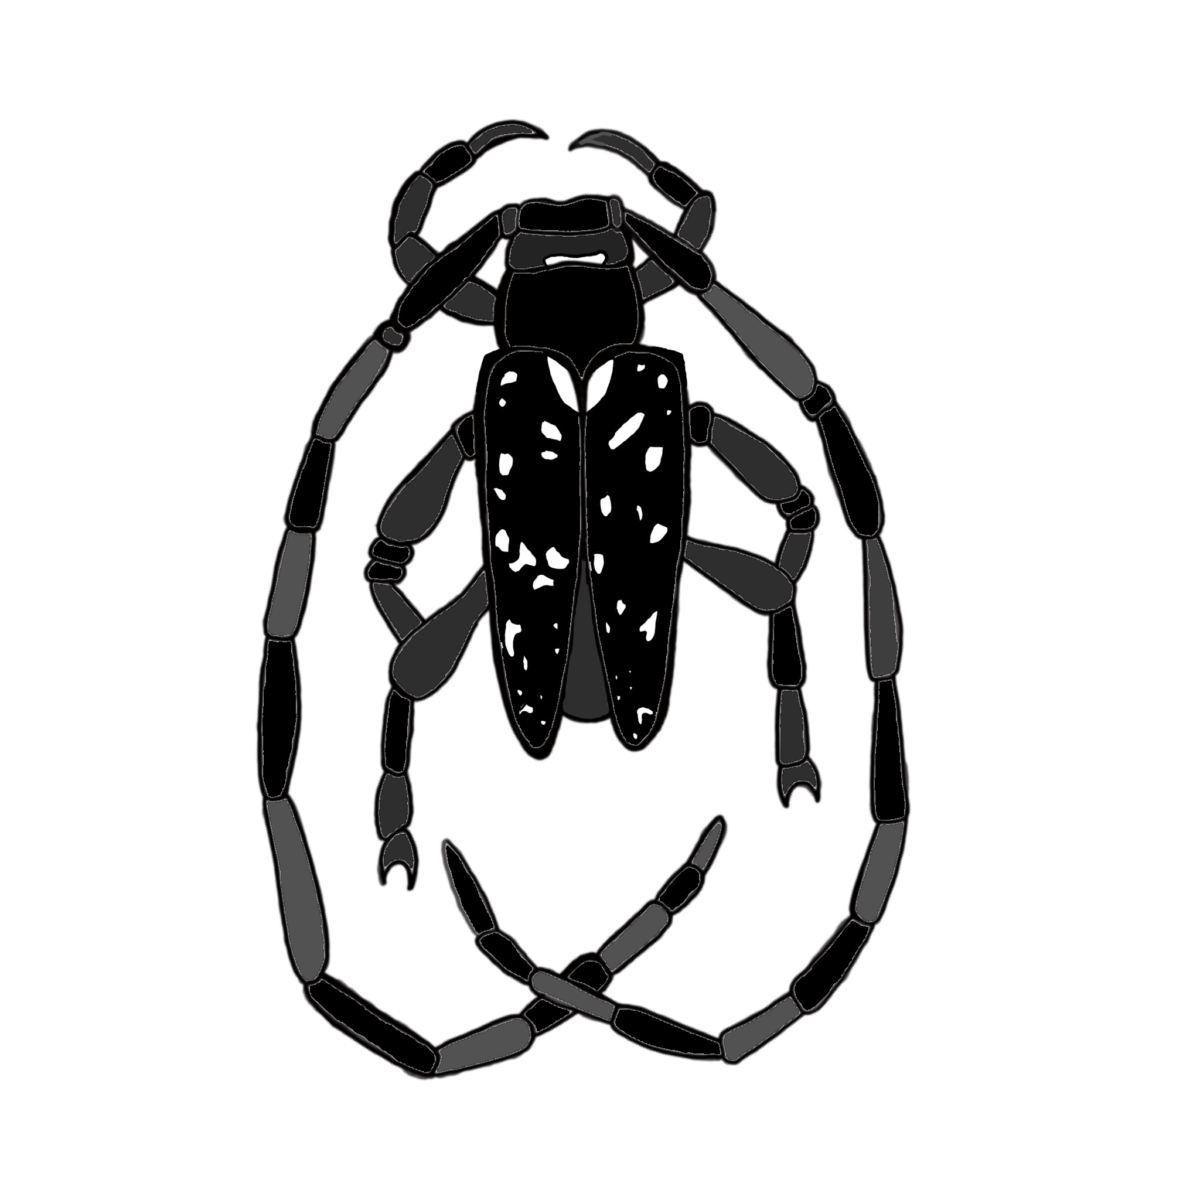
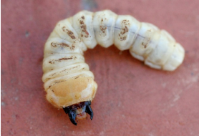
Vector: Monochamus beetles
M. clamator
M. scutellatus
Xylophagous as larvae
Adults feed on bark of dead or dying trees
Attracted to burn areas and facilitate forest succession after fire (Costello, Negrón, Jacobi, 2011).
Photograph by David Leatherman.

Slide 10
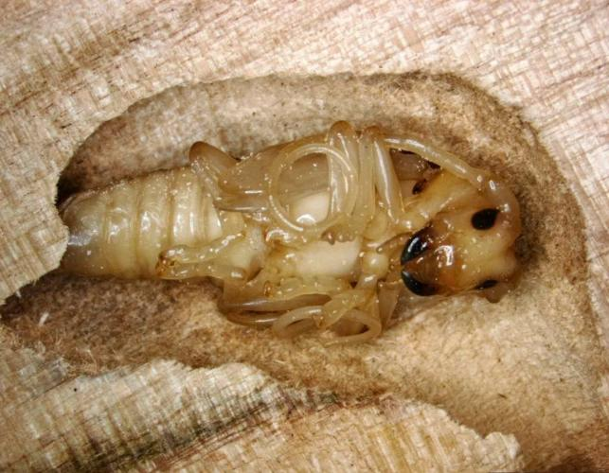
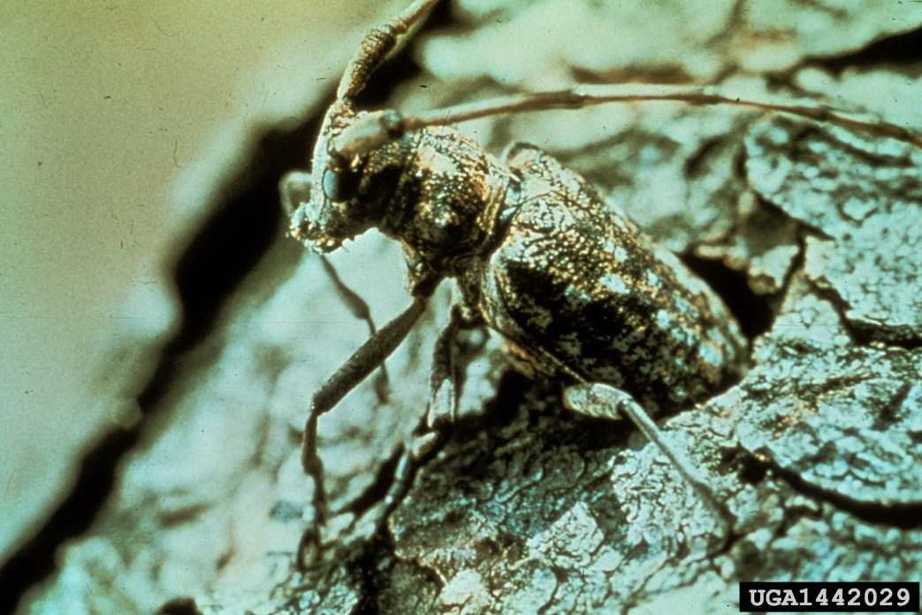
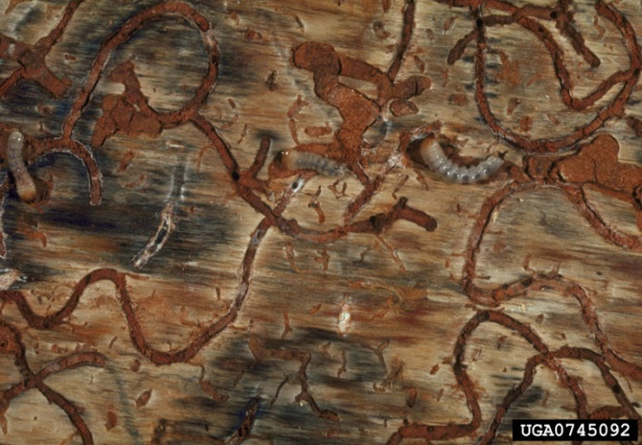
Missouri department of Conservation
USDA Forest Service
NSW Department of Primary Industries
Notes:
Detritivorous nutrient cyclers –galleries allow fungi to colonize facilitating decomposition and nutrient cycling while breaking down fuel load
Niche overlap

Slide 11
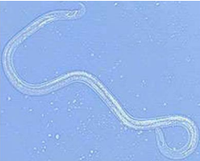
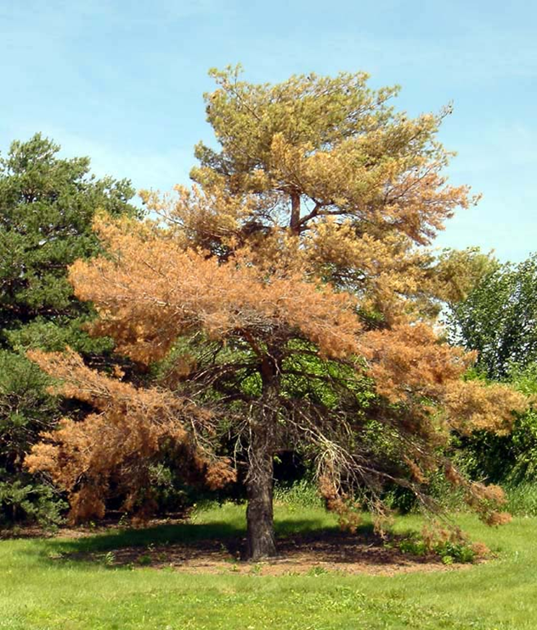
Pine Wilt Disease
D. Atkins, T.S. Davis and J.E. Stewart (5/20)
Vascular wilt
Bursaphelenchus xylophilus (pine wood nematode)
PWN is thought to be native to North America
Susceptible species: Scot’s pine, mugo pine, and Austrian pine (Atkins et al. 2020).
Laurie Stepanek, Nebraska Forest Service
Notes:
causes rapid death
How nematode enters tree
More destructive in nonnative range

Slide 12
How do disturbances, such as wildfire, influence the dynamics of disease transmission in forest ecosystems?
Hypothesis 1: A higher percentage of infected beetles will be prevalent closer to recently burned areas.
Hypothesis 2: Infected beetles will have a different flight phenology than uninfected beetles.
Hypothesis 3: Infection rates will vary on a temporal scale.

Slide 13
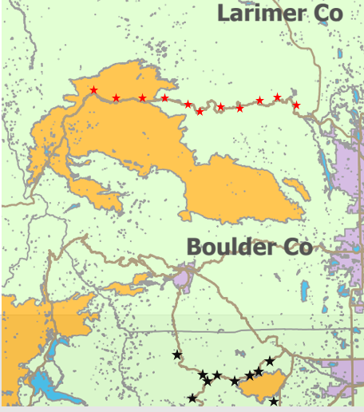
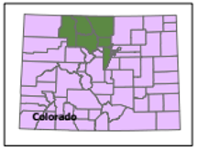
Study Site
0-15 km
Notes:
Gradient of distance to fire 0-15 km
Cameron peak – 209,000 acres – 4 months
First Year

Slide 14
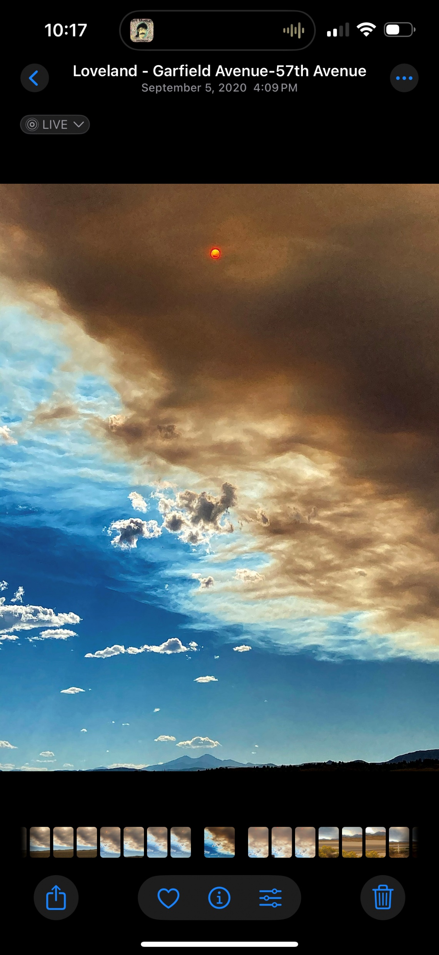
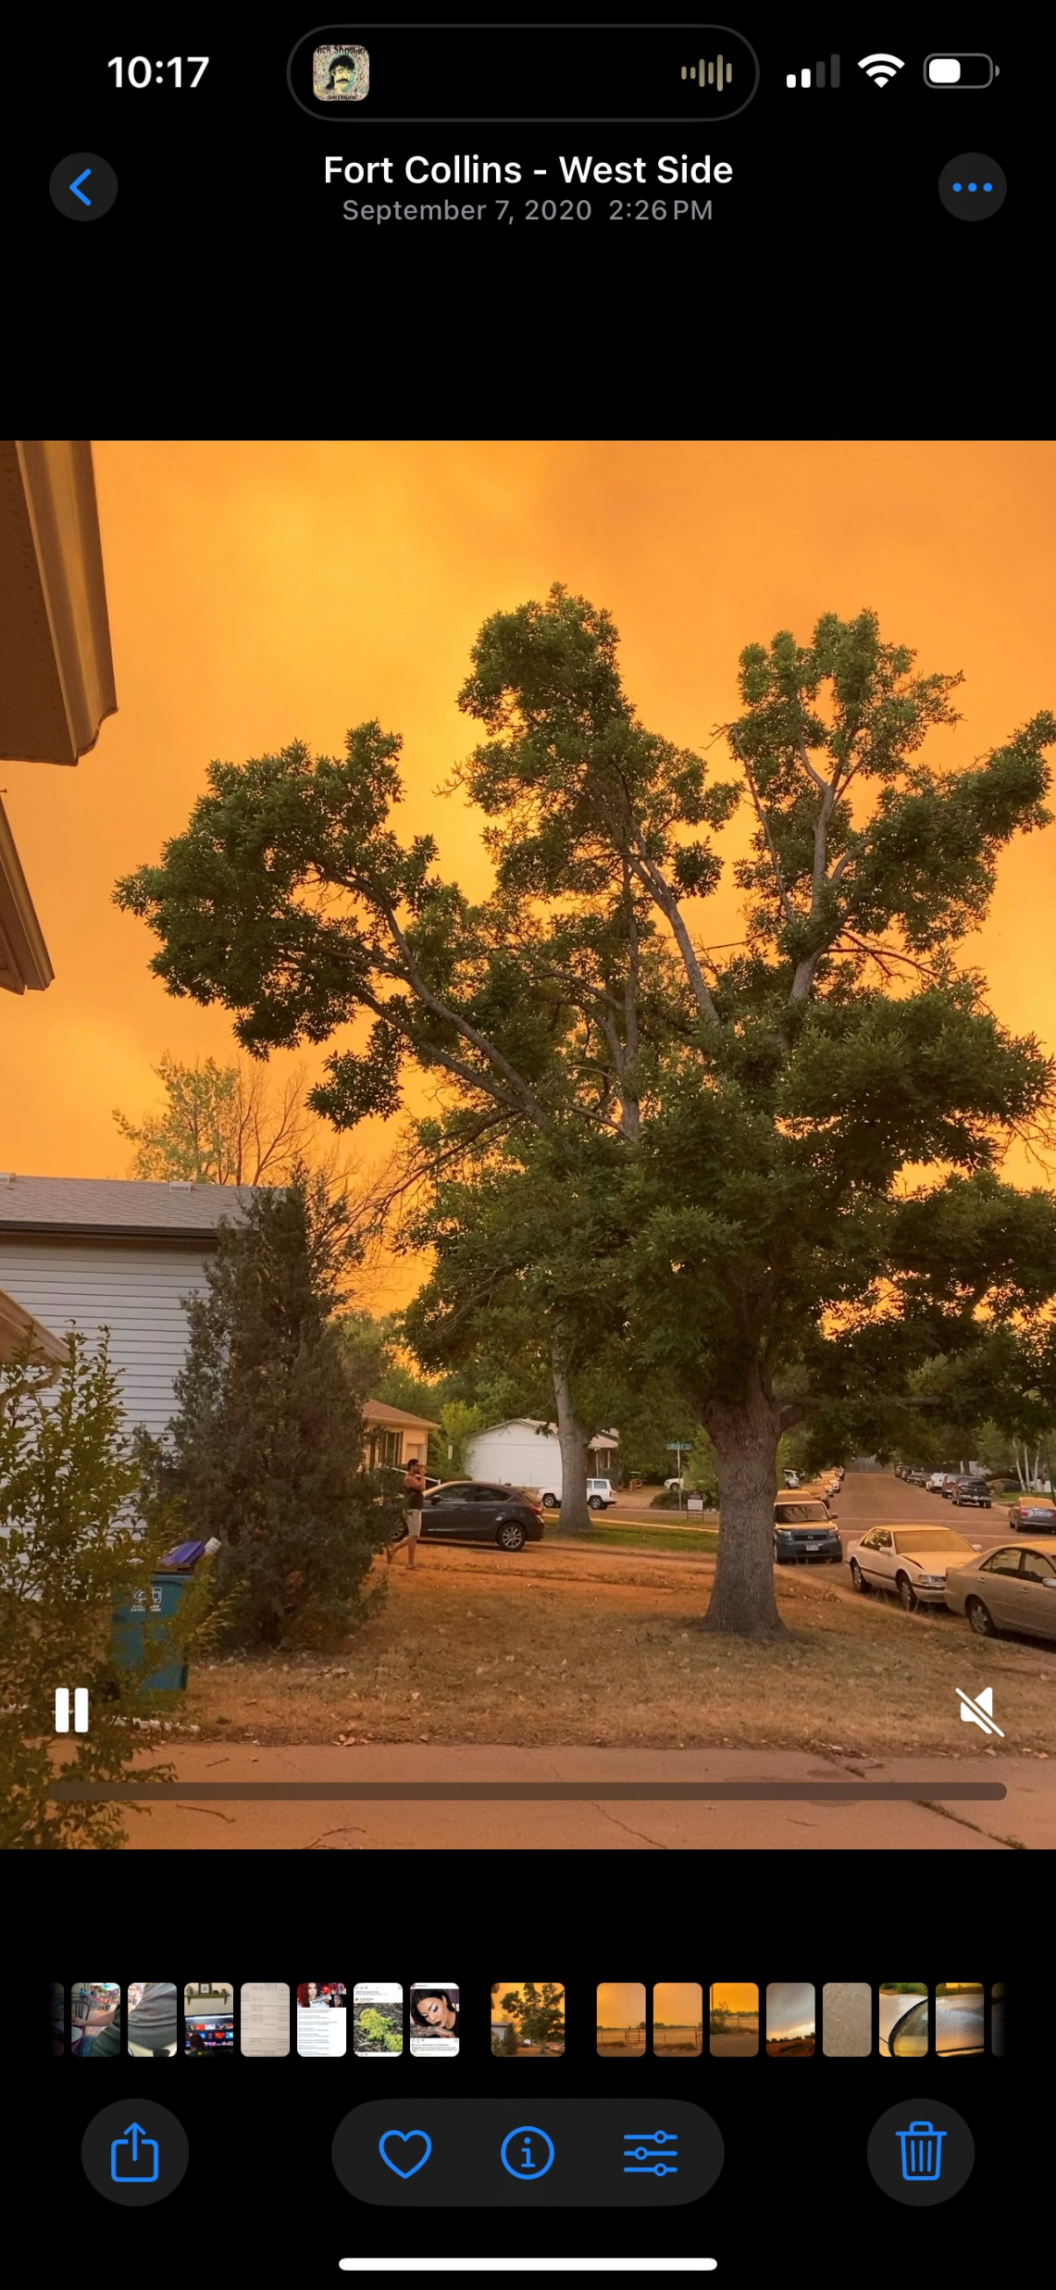
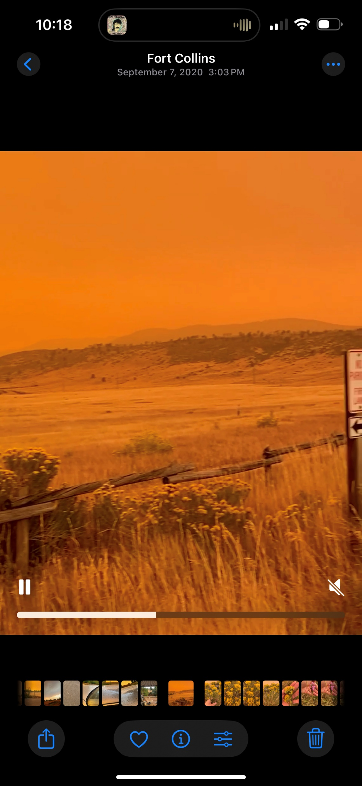
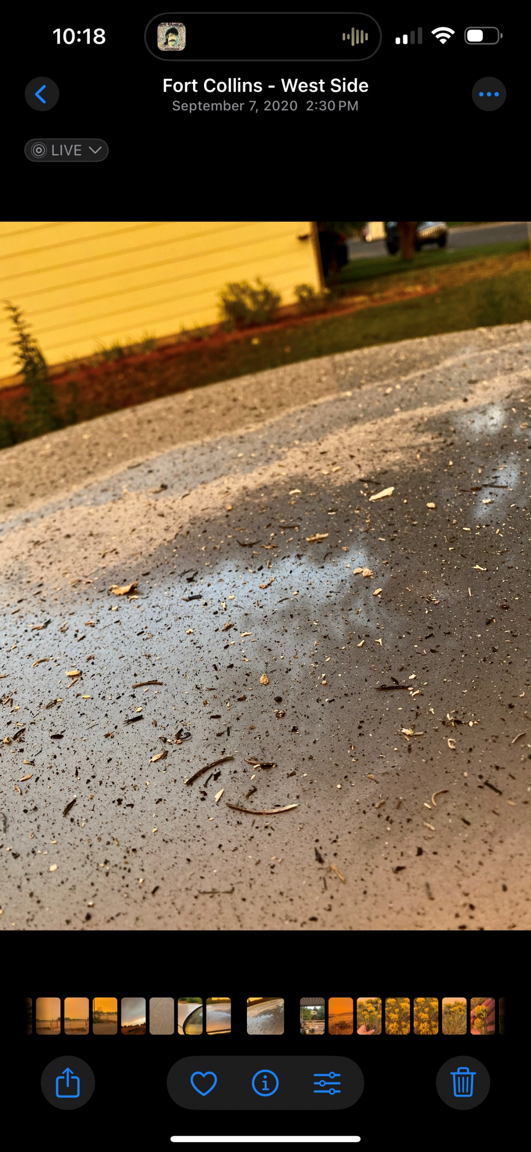
Notes:
CAM peak to my house is about 80 km

Slide 15
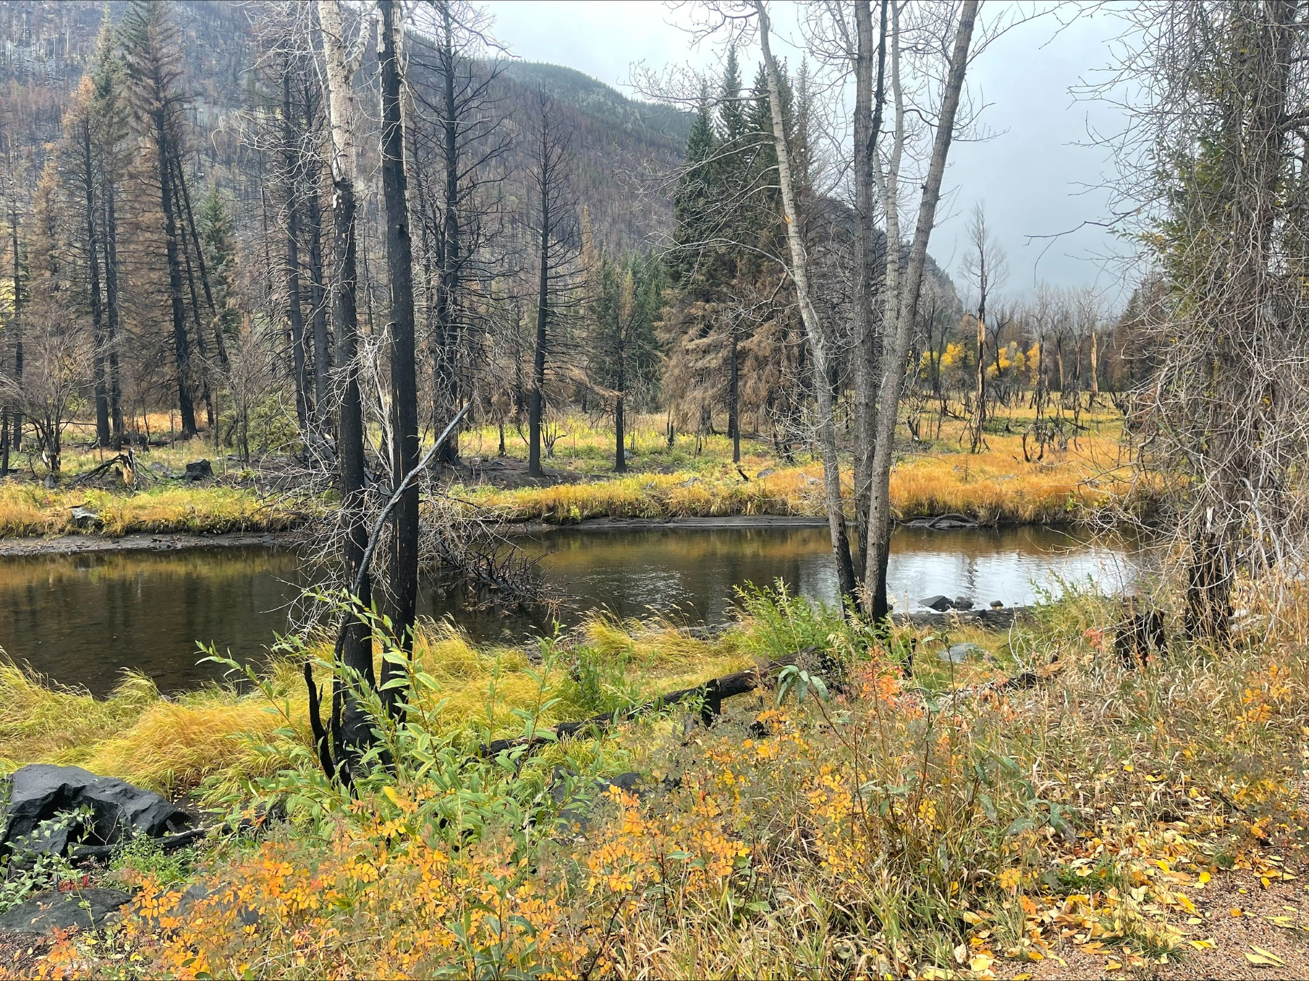

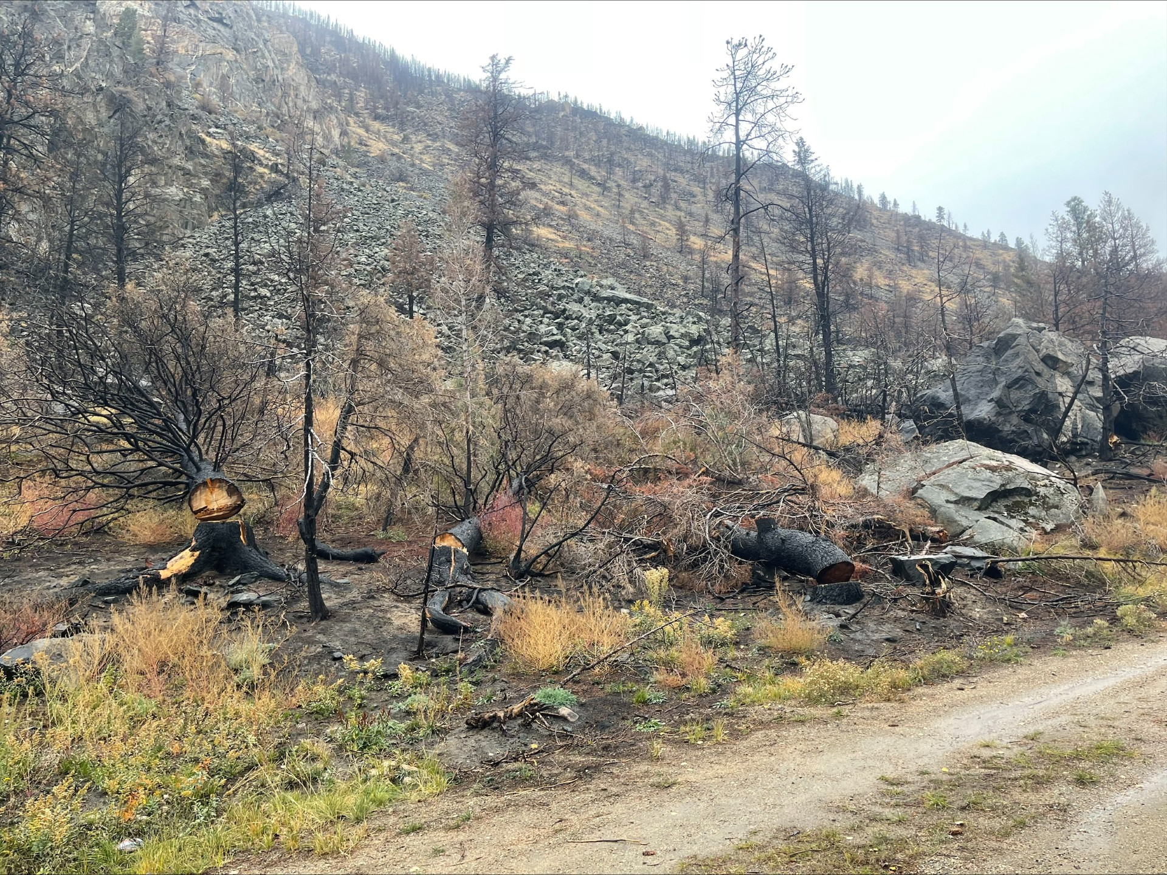
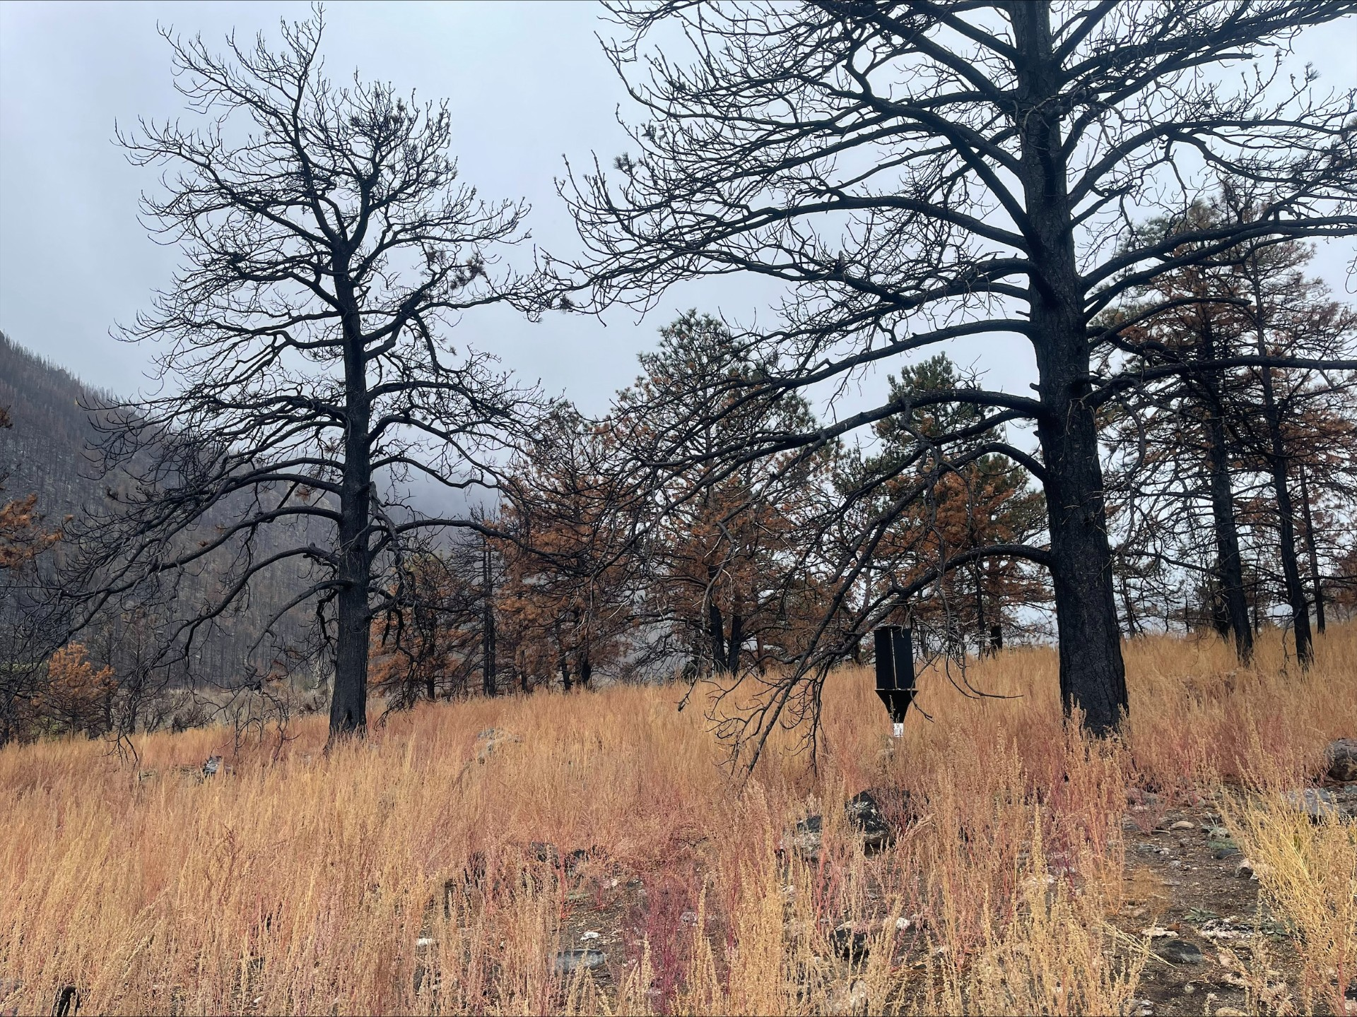
Trap Locations:
Trap Locations:

Slide 16

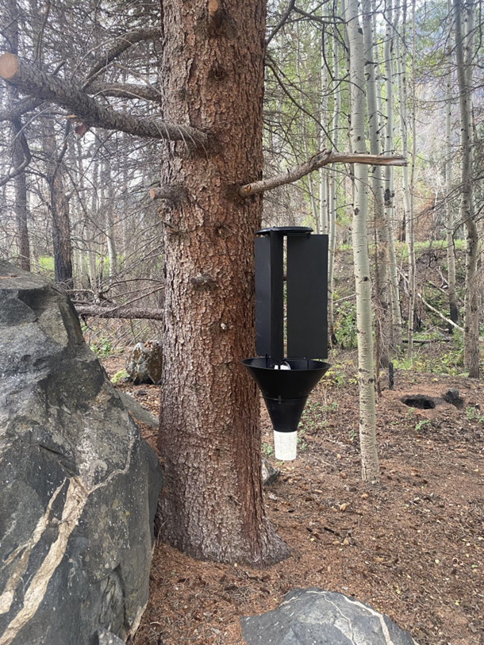

Methods:
Notes:
20 traps x 8 collections x 3 years
Monochamus lure (Synergy Semiochemicals) containing Monochamol, Ipsenol, alpha pinene, and ethanol
LAMP- Loop-mediated isothermal amplification test for nematode DNA
Japan

Slide 17
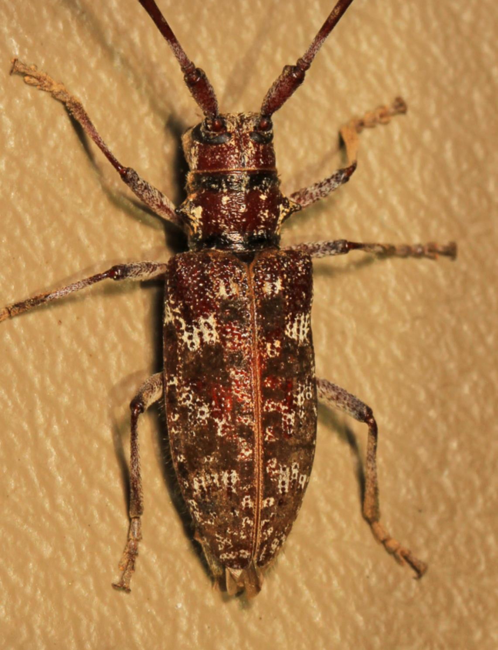
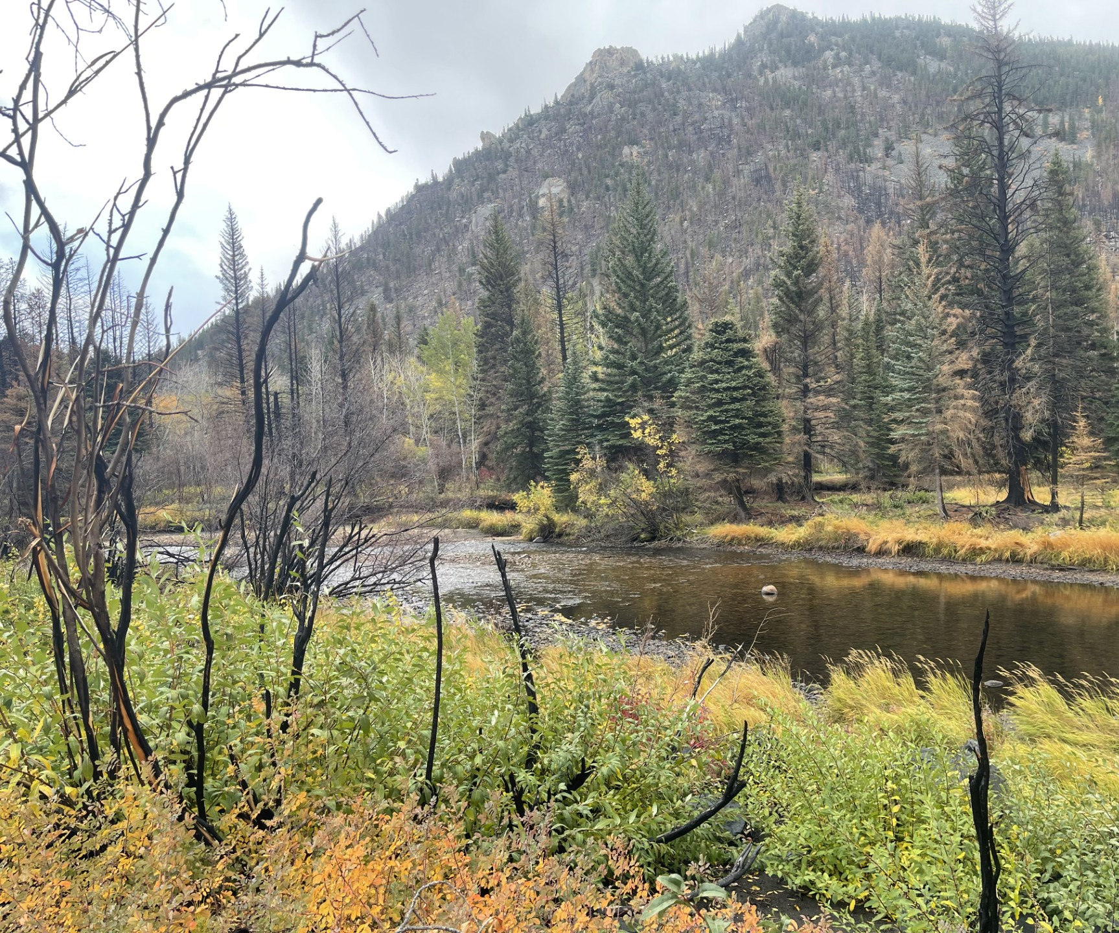

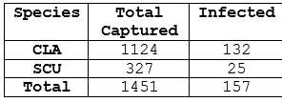
Results:

Slide 18
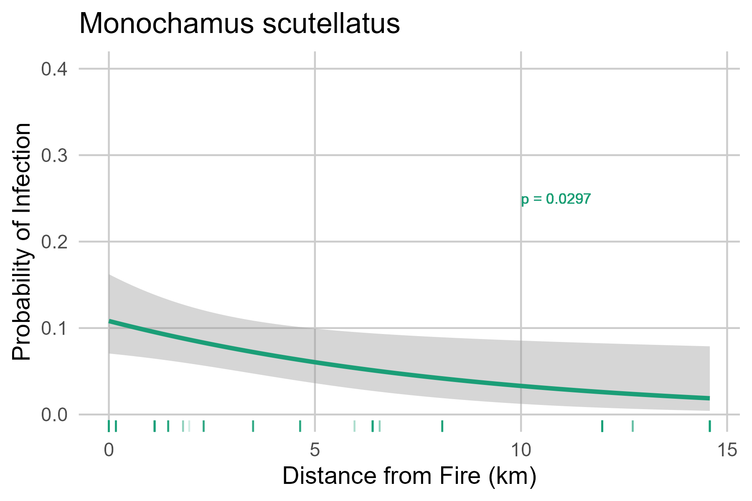
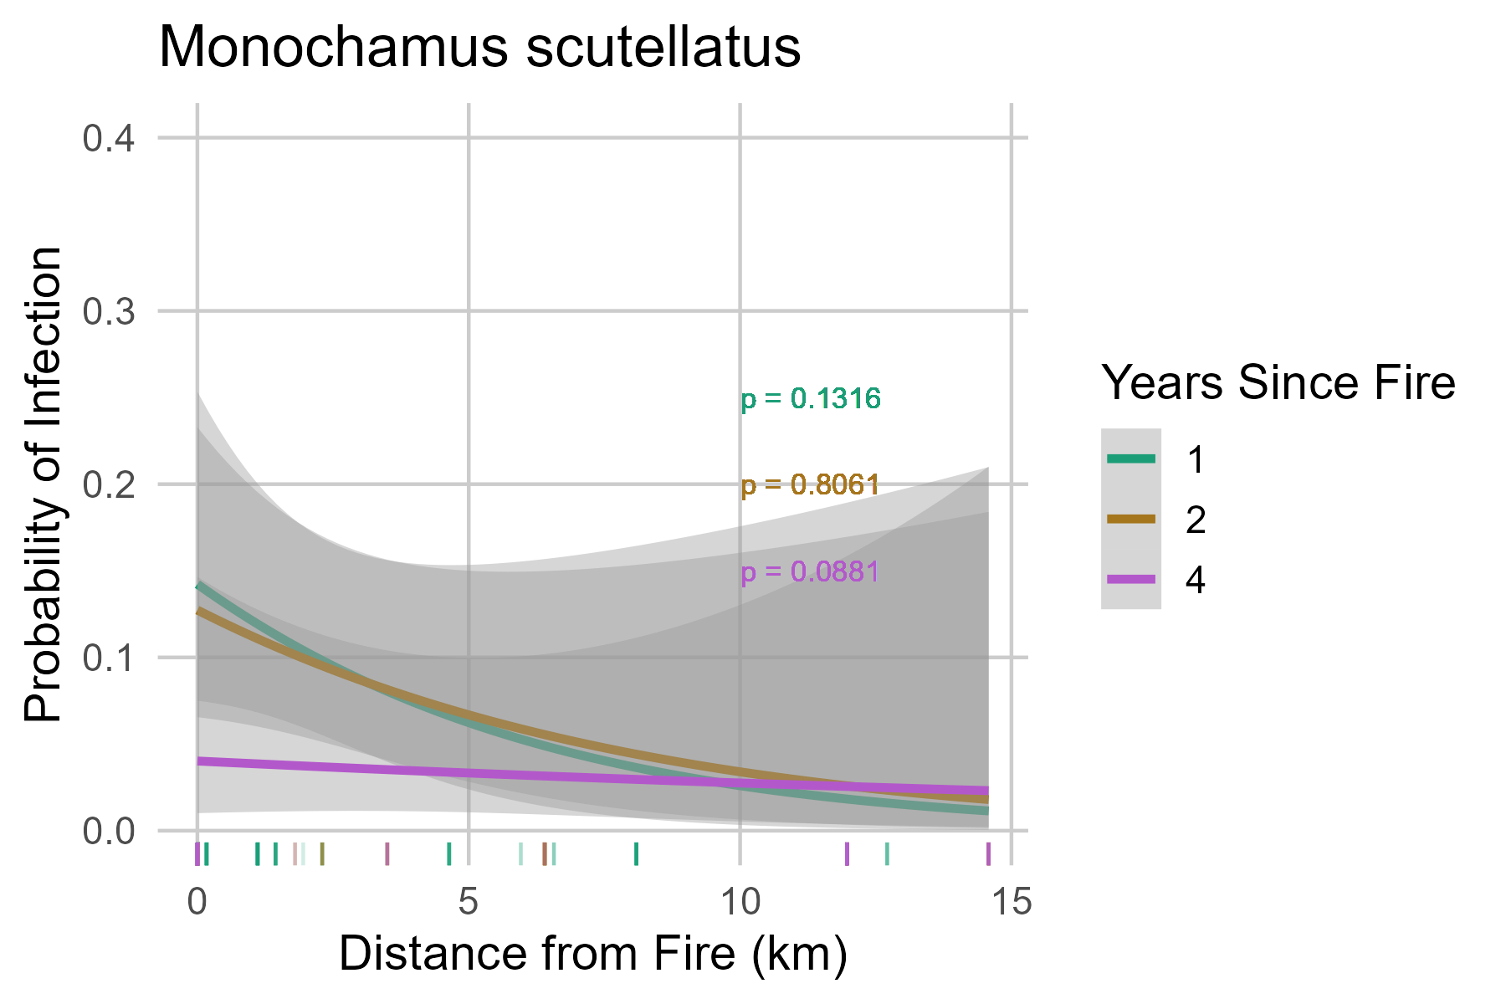
Hypothesis 1: A higher percentage of infected beetles will be prevalent closer to recently burned areas.
Notes:
Binomial logistic regression

Slide 19
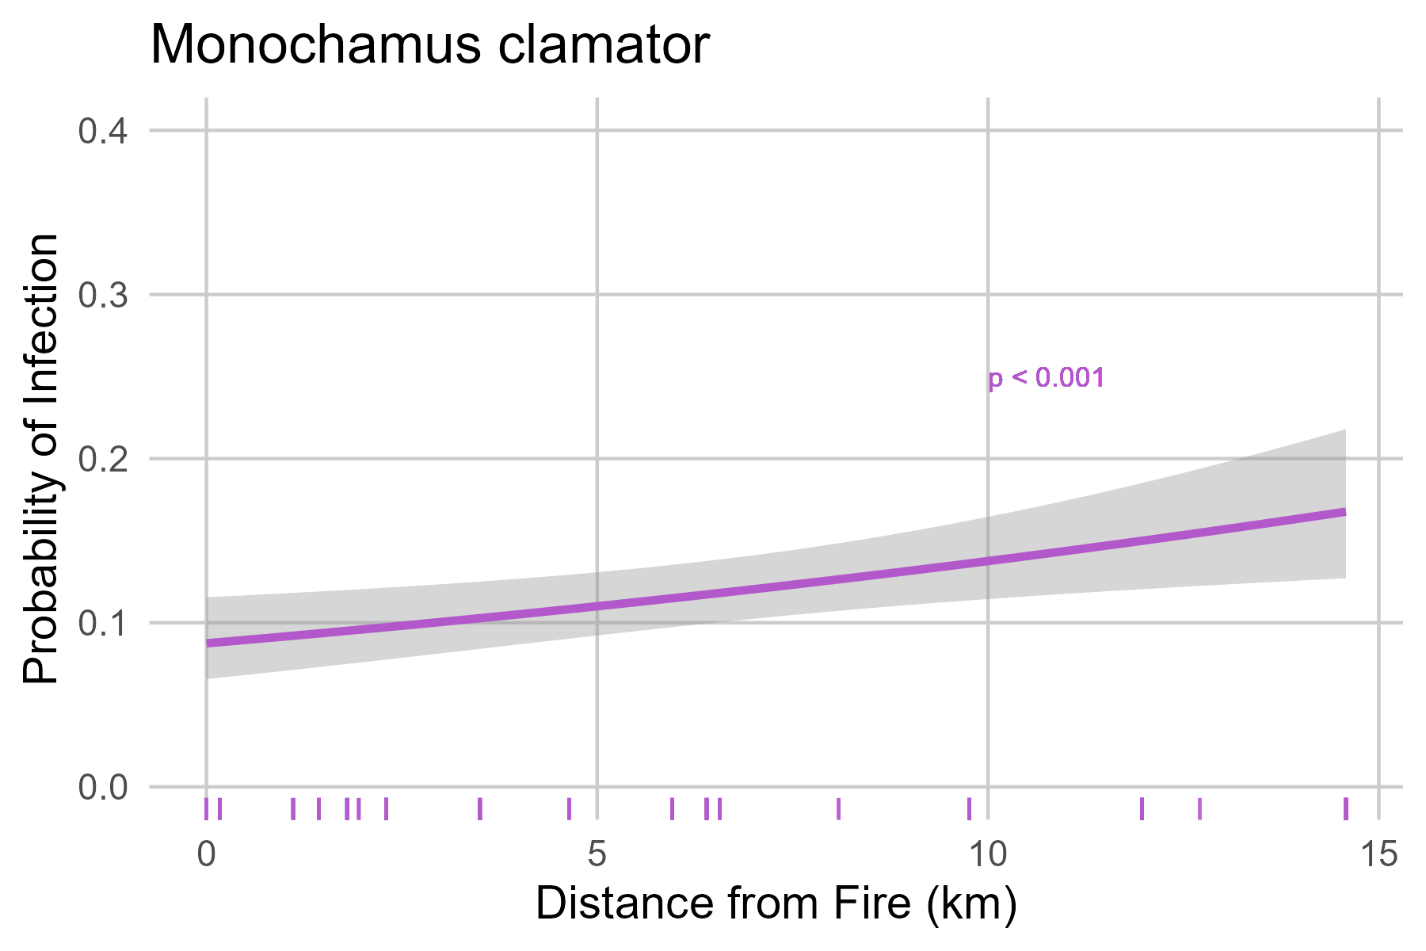
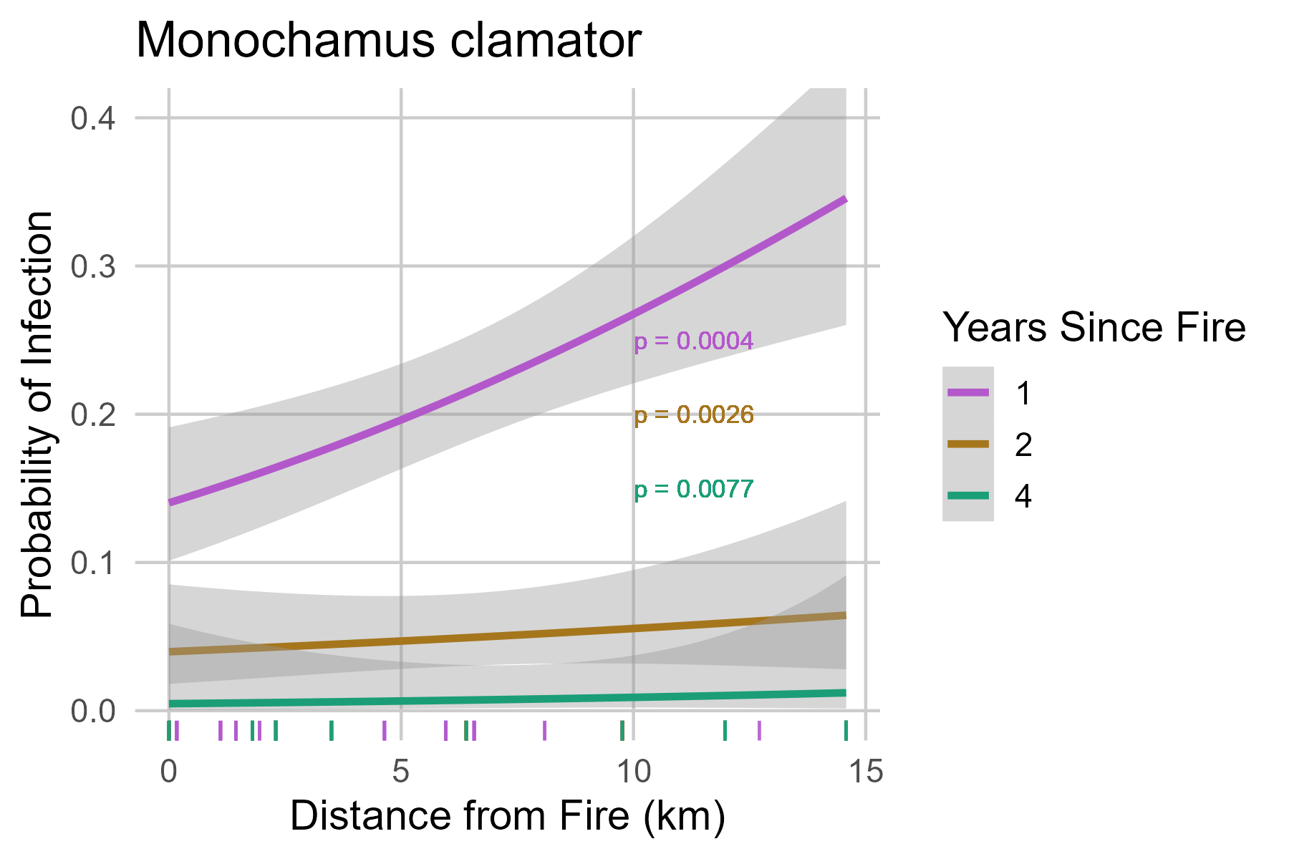
Hypothesis 1: A higher percentage of infected beetles will be prevalent closer to recently burned areas.
The percentage of infected beetles had a different relationship with distance to fire depending on species

Slide 20
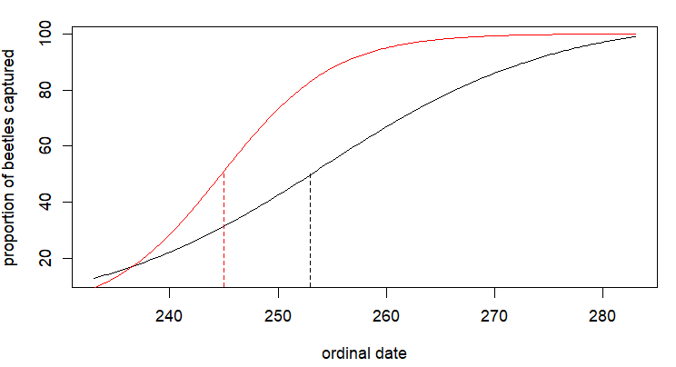
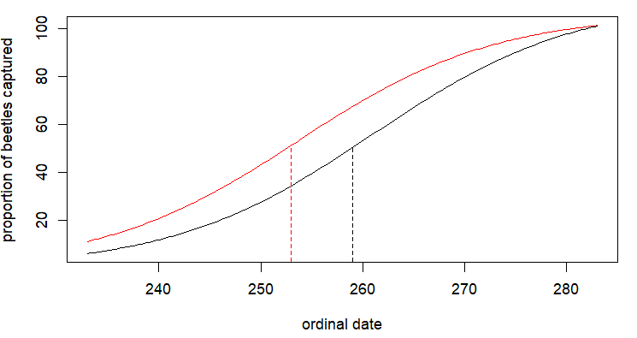
Hypothesis 2: Infected beetles will have a different flight phenology than uninfected beetles
M. clamator
M. scutellatus
Infected
Uninfected
Infected
Uninfected
Notes:
Cumulative logistic regression
PEAK in flight activity

Slide 21
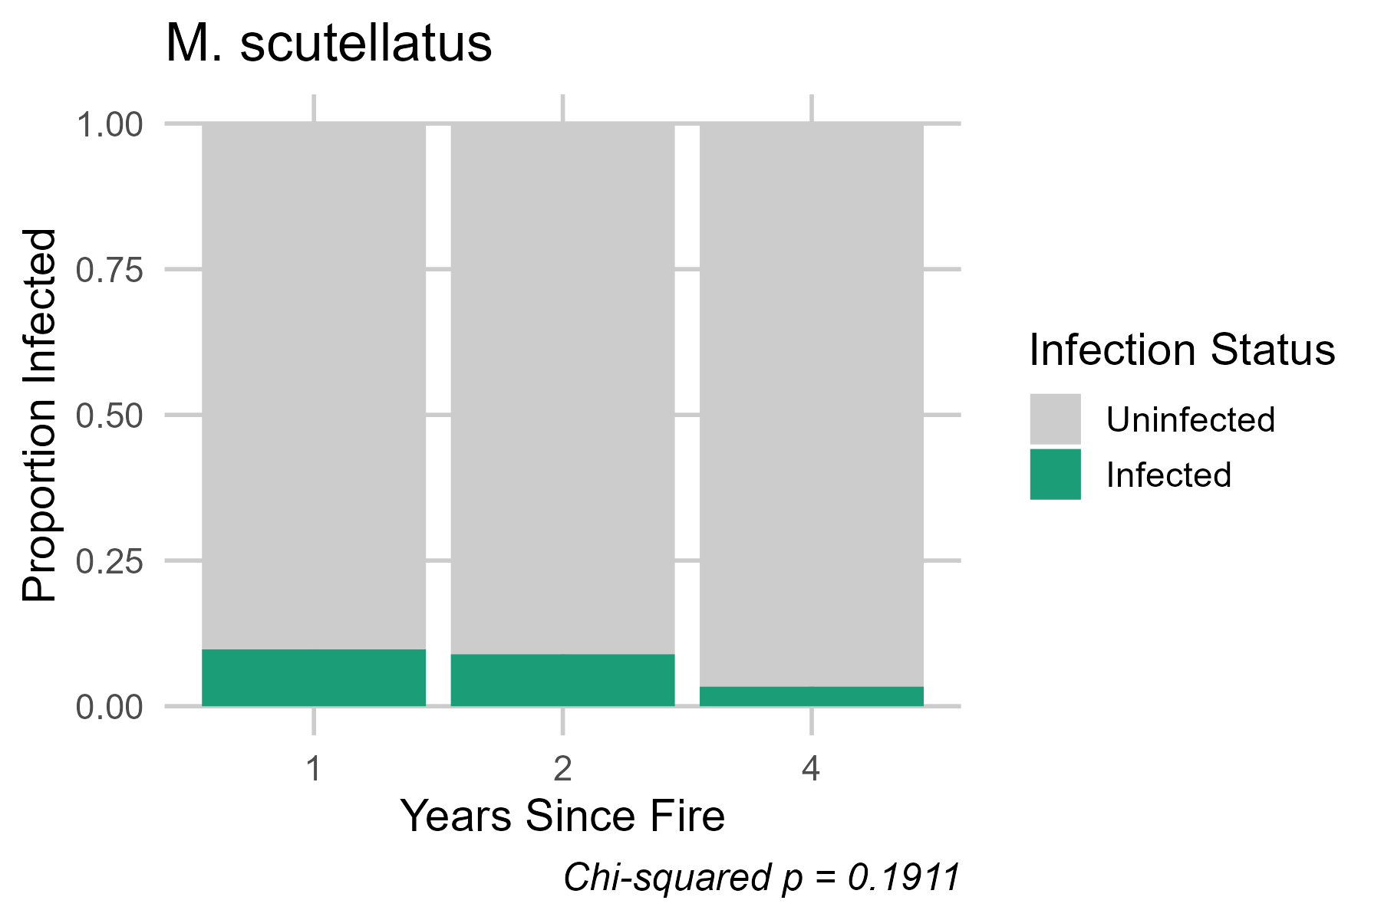
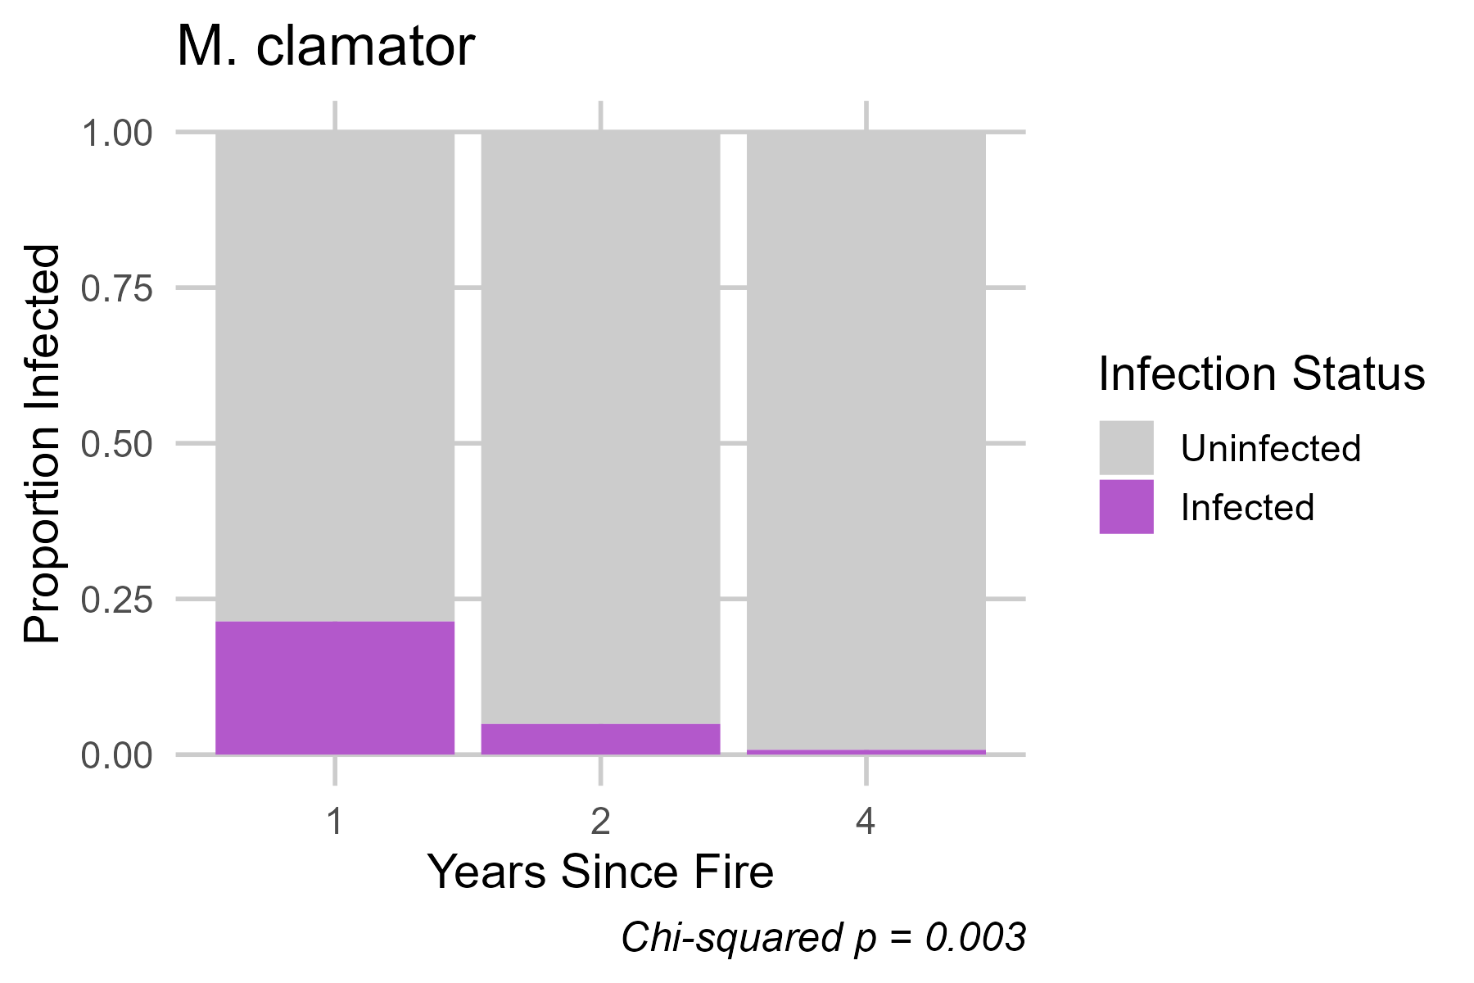
Hypothesis 3: Infection rates will vary on a temporal scale.
Notes:
Chi squared test to look at infection rate over time.

Slide 22
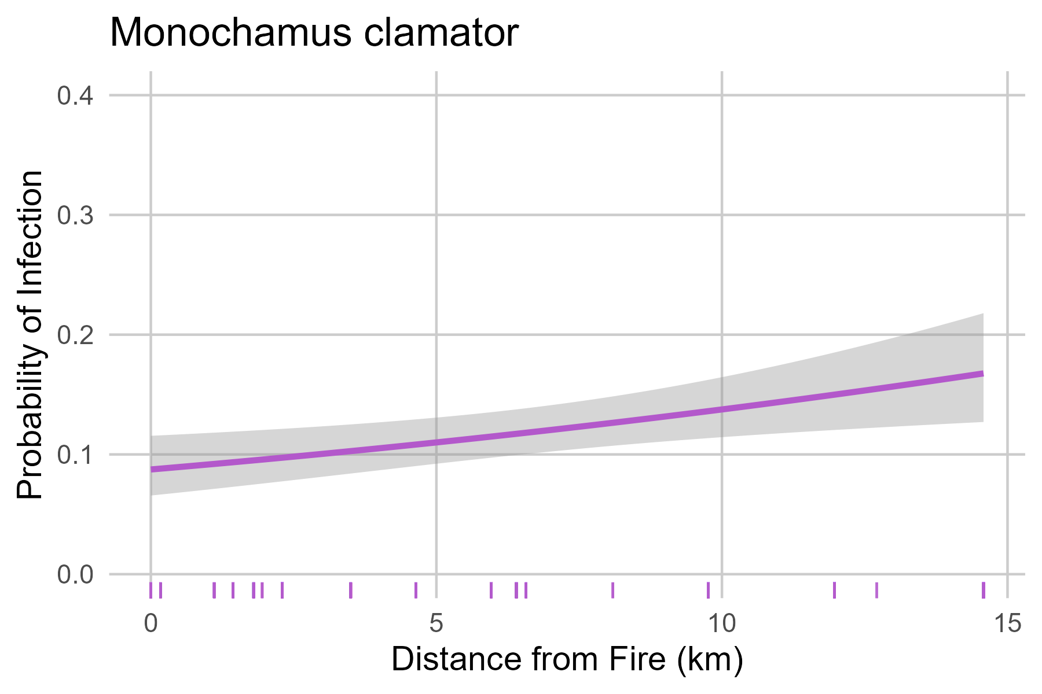
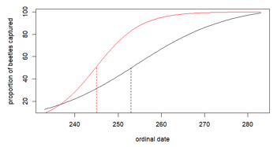
Discussion:
The percentage of infected beetles had a different relationship with distance to fire depending on species
Infected Monochamus beetles exhibited a peak in flight activity approximately a week earlier than uninfected beetles
Infection rates decrease over time since disturbance.
Future Directions:
Other locations
More landscape analysis
Tree infection rates in addition to vectors
Other disturbances
Notes:
Logistic- contrasting patterns- mention limitation- history of fire disturbance could complicate interpretation of observed associations
could narrow scope of target species management
Peak flight timing could mean earlier emergence. Could be related to physiological stress alter behavior
Implications for disease dynamics- greater opportunity to interact with healthy trees before
Spread earlier in season especially post fire
Trap directly after disturbance when risk is greatest.
SCU might have a stronger relationship with spruce biotic disturbance than fire

Slide 23




Acknowledgements:
NSF Award #2046109 to TS Davis
National Forest System (USFS)
Dr. Seth Davis (CSU)
Dr. Jane Stewart (CSU)
Dr. Jorge Ibarra Caballero (CSU)
Nathan Comai (CSU)
Jacob Yastrow (CSU)
Email: Hailee.Nolan@colostate.edu
Notes:
*GDPE

Slide 24
References
Atkins, D. H., Davis, T. S., & Stewart, J. E. (2021). Probability of occurrence and phenology of pine wilt disease transmission by insect vectors in the Rocky Mountains. Ecological Solutions and Evidence, 2(1)
Boulanger, Y., Sirois, L., & Hébert, C. (2013). Distribution patterns of three long-horned beetles (Coleoptera: Cerambycidae) shortly after fire in boreal forest: Adults colonizing stands versus progeny emerging from trees. Environmental Entomology, 42(1)
Costello, S. L., Negrón, J. F., & Jacobi, W. R. (2011). Wood-boring insect abundance in fire-injured ponderosa pine. Agricultural and Forest Entomology, 13(4)
Jung, Kim, M., Nam, Y., & Koh, S.-H. (2020). Changes in spatial and temporal distributions of Monochamus beetles along the fire severity in burned Pinus densiflora forests. Journal of Asia-Pacific Entomology, 23(2)
Pimentel, C. S., Ayres,M. P., Vallery, E., Young, C., & Streett, D. A. (2014). Geographical variation in seasonality and life history of pine sawyer beetles
Monochamus spp: Its relationship with phoresy by the pinewood nematode Bursaphelenchus xylophilus. Agricultural and Forest Entomology, 16,
196–206.Ray, C., Cluck, D. R., Wilkerson, R. L., Siegel, R. B., White, A. M., Tarbill, G. L., Sawyer, S. C., & Howell, C. A. (2019). Patterns of woodboring beetle activity following fires and bark beetle outbreaks in montane forests of California, USA. Fire Ecology, 15(1)
Saint-Germain, M., Drapeau, P., & Hébert, C. (2004). Landscape-scale habitat selection patterns of monochamus scutellatus (Coleoptera: Cerambycidae) in a recently burned black spruce forest. Environmental Entomology, 33(6)
Vicente, Nascimento, F. X., Espada, M., Barbosa, P., Hasegawa, K., Mota, M., & Oliveira, S. (2013). Characterization of bacterial communities associated with the pine sawyer beetle Monochamus galloprovincialis, the insect vector of the pinewood nematode Bursaphelenchus xylophilus. FEMS Microbiology Letters, 347(2)

